Slide 1
26th February 2010
Objective: to be able to generate a sequence from the nth term. (Level 6)
Skills: Making Links and Reasoning
By the end of the lesson:
All: will be able to write the first 5 terms of a sequence from the n^{th} term
Most: will be to know any term in a sequence from the n^{th} term
Some: will be able to reason why a number can or cannot be in a sequence from the n^{th} term

Slide 2
Starter
Find the n^{th} term of the following sequences.
5, 10, 15, 20, 25, ...
4, 9, 14, 19, 24, ...
3, 6, 9, 12, 15, ...
9, 15, 21, 27, 33, ...
8, 10, 12, 14, 16, ...
9, 16, 23, 30, 37, ...

Slide 3
The Rule
Remember what does 2n + 3 actually mean. Write the 2 steps in your books.
We are going up by 2’s at each step
At position 1 (1st term) we add 3 to 2.

Slide 4
Listing a sequence form the n^{th} term
Now we understand this, see if you can list the first 5 terms of the sequence 2n
2, 4, 6, 8, 10, ....

Slide 5
Listing a sequence form the n^{th} term
Now we understand this, see if you can list the first 5 terms of the sequence 2n + 3
5, 7, 9, 11, 13, ....

Slide 6
Listing a sequence form the n^{th} term
Now we understand this, see if you can list the first 5 terms of the sequence 5n - 3
2, 7, 12, 17, 22, ....

Slide 7
How can we find the n^{th} term?
Look at the n^{th} term:
3n
Look at the n^{th} term:
3n – 2

Slide 8
Questions
List the first 5 terms of the following sequences from the n^{th} term
Green
3n-1
4n
2n+7
4n-2
6n-2
Red
4n-4
5n-4
6n-4
8n+1
6n - 10

Slide 9
Answers
Green
2, 5, 8, 11, 14
4, 8, 12, 16, 20
9, 11, 13, 15, 17
2, 6, 10, 14, 18
4, 10, 16, 22, 28
Red
0, 4, 8, 12, 16
1, 6, 11, 16, 21
2, 8, 14, 20, 26
9, 17, 25, 33, 41
-4, 2, 8, 14, 20

Slide 10
Harder Sequences
-n
-3n
-4n +5
-5n -3
n²
n² + n
3n²

Slide 11
Answers
-1, -2, -3, -4, -5, ...
-3, -6, -9, -12, -15, ...
1, -3, -7, -11, -15, ...
-8, -13, -18, -23, -28
1, 4, 9, 16, 25, ...
2, 6, 12, 20, 30, ...
3, 12, 27, 48, 75, ...

Slide 12
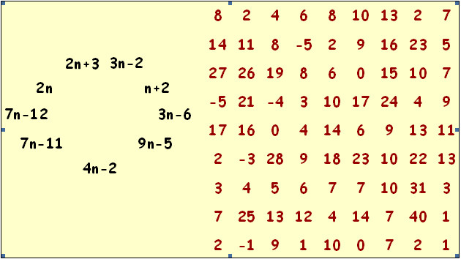
Find nine sequences in this grid.
Then match them to their n^{th} term.
Good Luck

